Slide 1
Interesting facts about
Queen Elizabeth II
The work was done by Volodina Alisa 9A

Slide 2
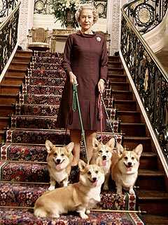
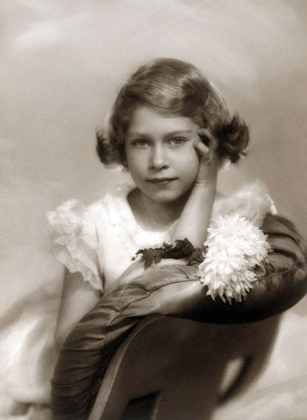
The Queen has 30 godchildren.
Her childhood nickname was Lilibet because she couldn’t pronounce Elizabeth.
The Queen has owned more than 30 corgis during her reign, starting with Susan who was a present for her 18th birthday in 1944. Her Majesty has three corgis – Monty, Willow and Holly.

Slide 3
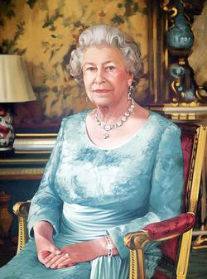
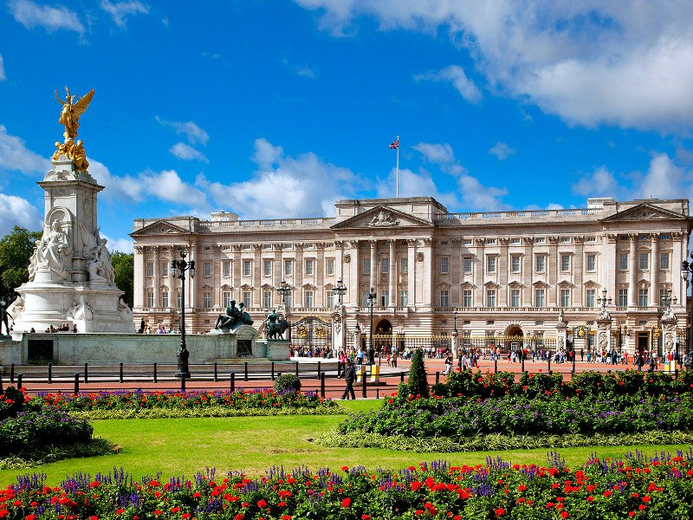
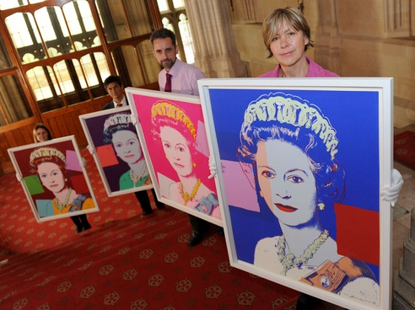
She has given around 90,000 Christmas puddings to staff.
She has sat for 129 portraits during her reign.
About 1.5 million people have attended garden parties at Buckingham Palace or the Palace of Holyroodhouse in Scotland since Elizabeth has been on the throne.

Slide 4
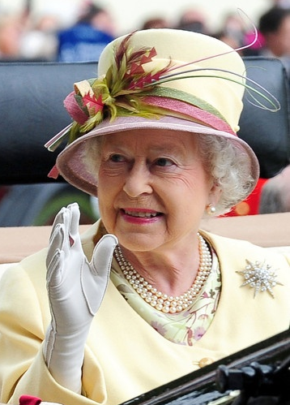
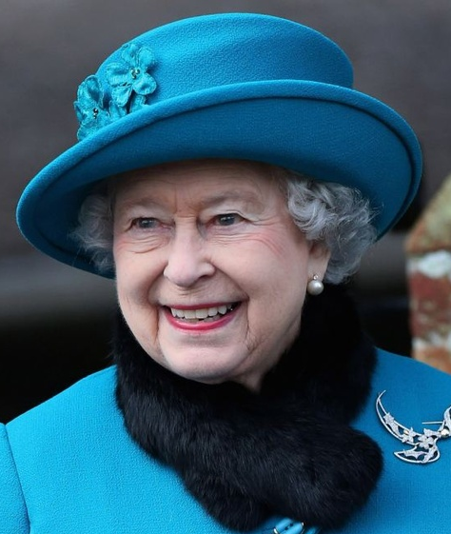
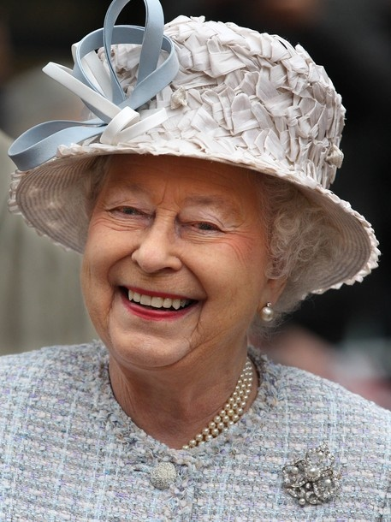
During her reign she has answered some three million items of correspondence.
There have been 12 U.S. Presidents during her reign.
The Queen Elizabeth II has worn at least 5,000 hats since her rule began in 1952.

Slide 5
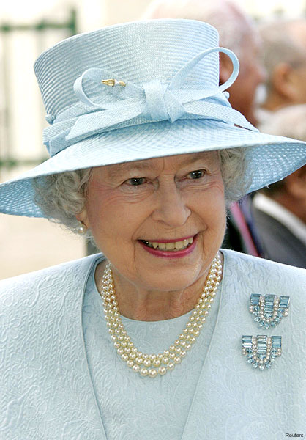
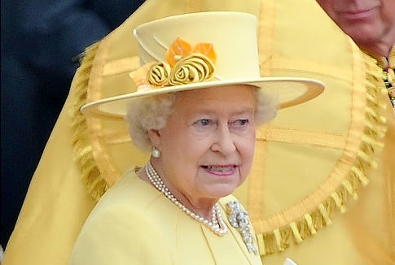
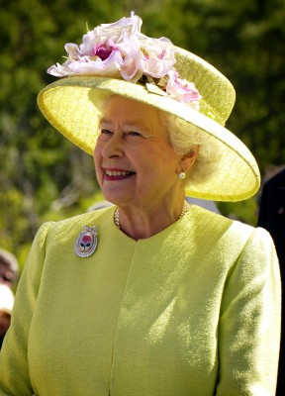
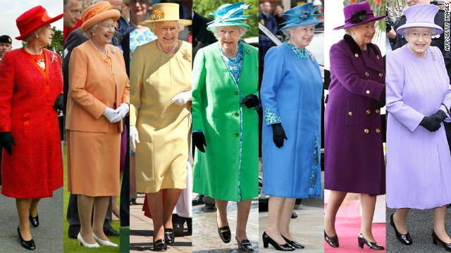

Slide 6
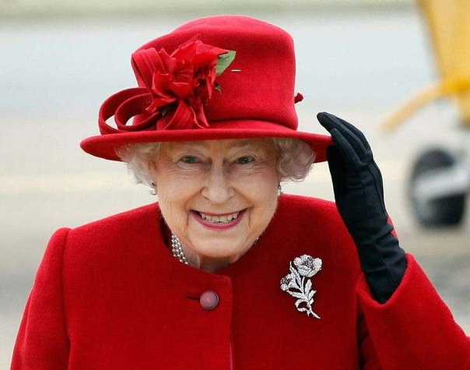
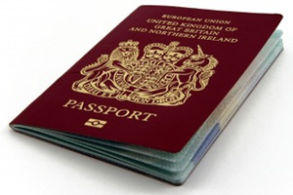
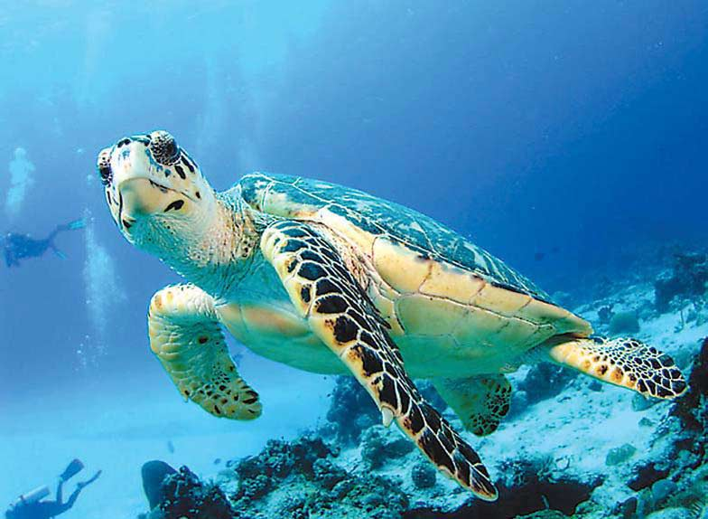
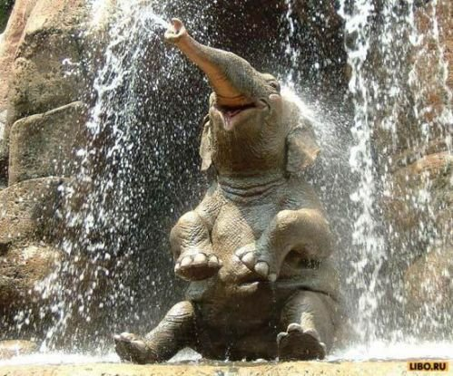
The Queen is the only person in Britain who is not required to have a passport.
Unusual live gifts given to her on royal tours include two tortoises and a seven-year-old bull elephant.

Slide 7
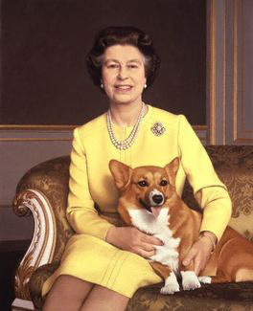
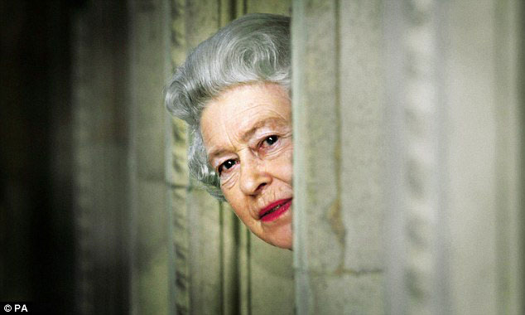
Each morning, the Queen starts the day with a cup of tea. At 7:30 a.m. her "morning tray" is brought into her bedroom bearing a silver teapot, a water jug and milk, and a dish of biscuits for her dogs.

