Slide 1
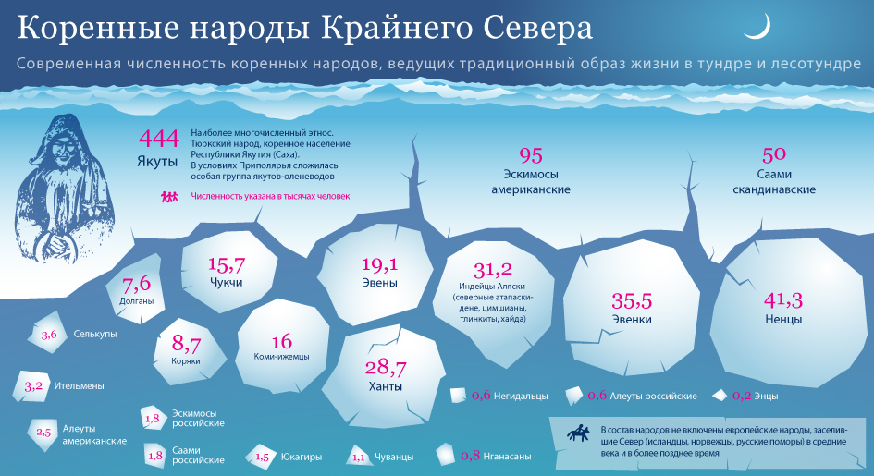
DISCRIMINATION OF NORTHERN PEOPLES

Slide 2
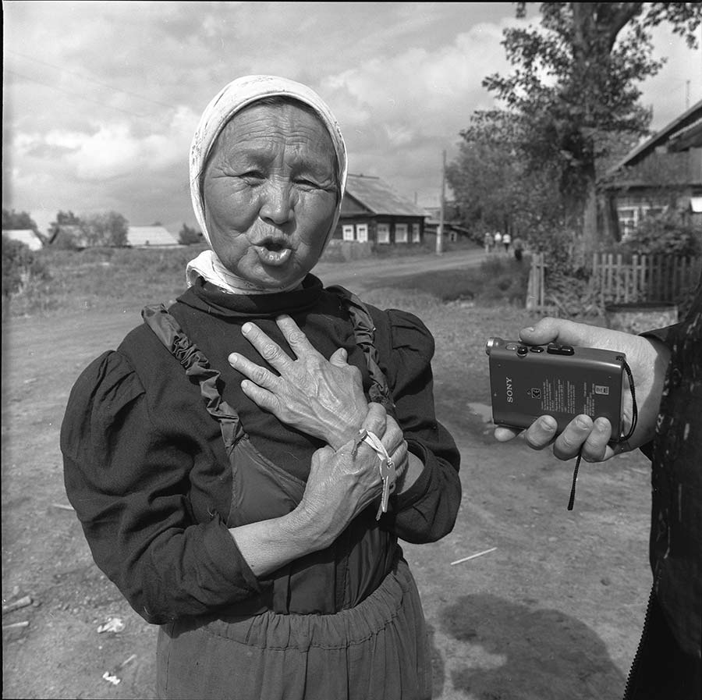
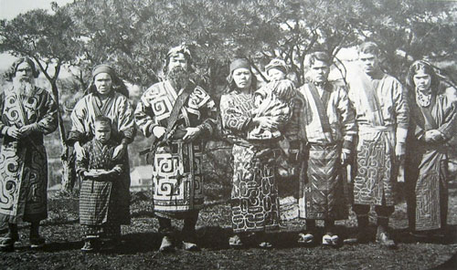
Census 1926
in Komi Republic the share of indigenous population-94%
In regions of the Far North-120 thousand people
on the share of Russian population-44 thousand people

Slide 3
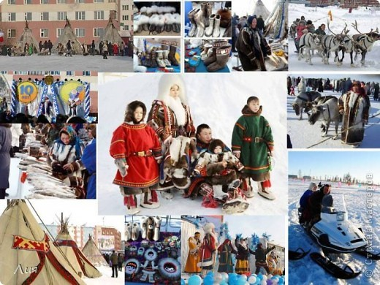
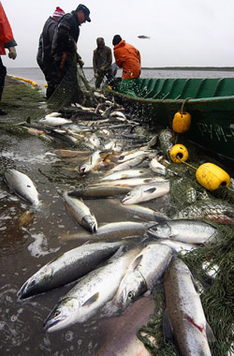
in the 20's Northern policy of the Soviet state is directed on strengthening of the state control in the fields of traditional economy

Slide 4
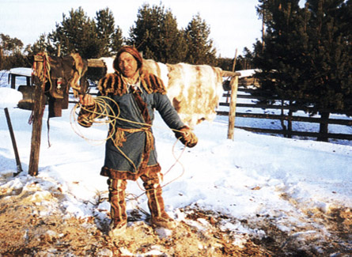
In result
extremely high rates of unemployment, mortality, alcoholism
1989-1997г- mortality rate of Komi people exceeded twice the mortality rate of Russian people

Slide 5
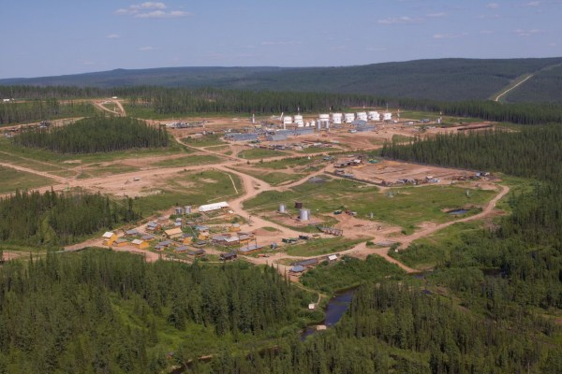
The North Gives
70% of foreign exchange is revenues of the state
The problem is the complexity of the adoption of laws to protect indigenous peoples.

Slide 6
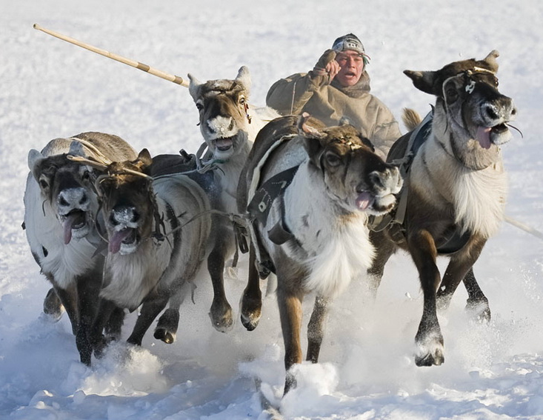
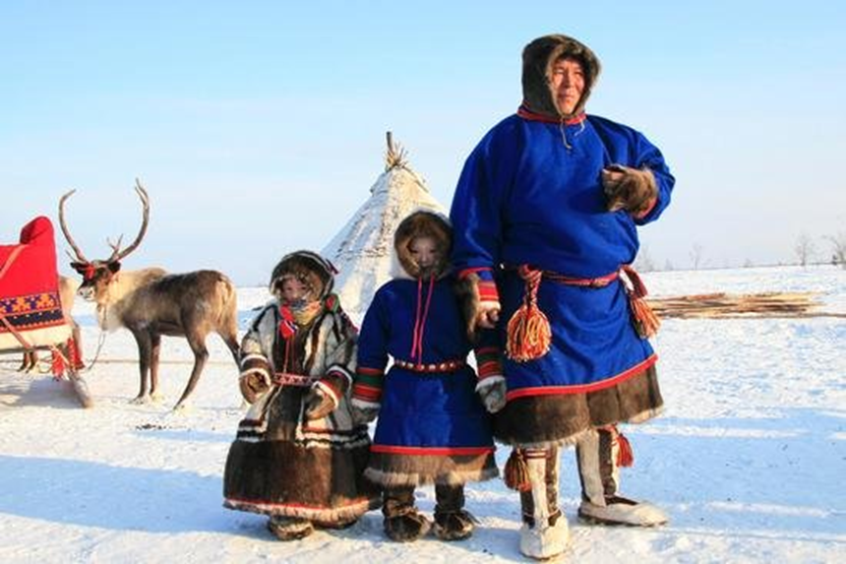
Life expectancy
indigenous population of the North is less than the Russian average, 9 years
Eskimos in Russia live 45 years, in Alaska-72 years

Slide 7
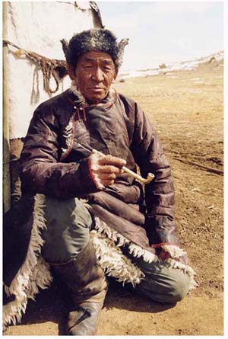
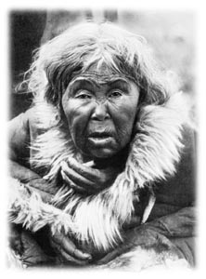
Unemployment
In the Amur region.
Unemployment of the able-bodied indigenous population was 51%,
in the region -12%,
in Russia - 8%.

Slide 8
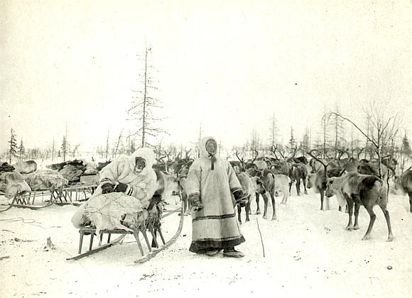
The Problem
Northern peoples have no genetic protection against many infectious diseases and alcohol.
According to RAMS mortality from alcoholism is 15-20 times higher than the national average

Slide 9
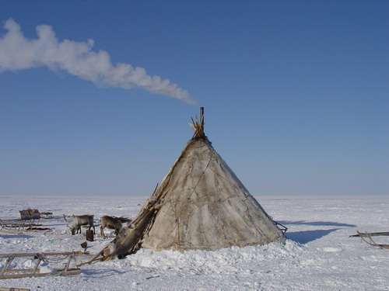
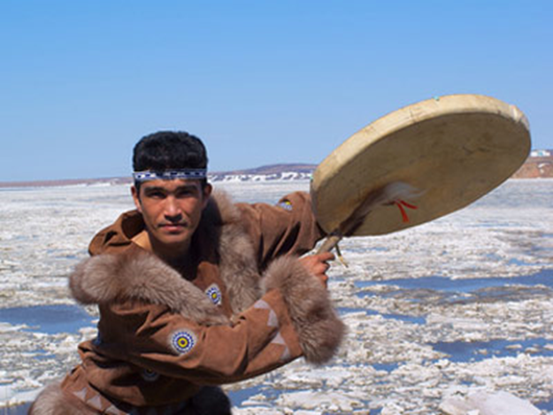
Now
Northern regions of Russia is home to 11 million people
Of them
200 thousand of them are indigenous people

Slide 10
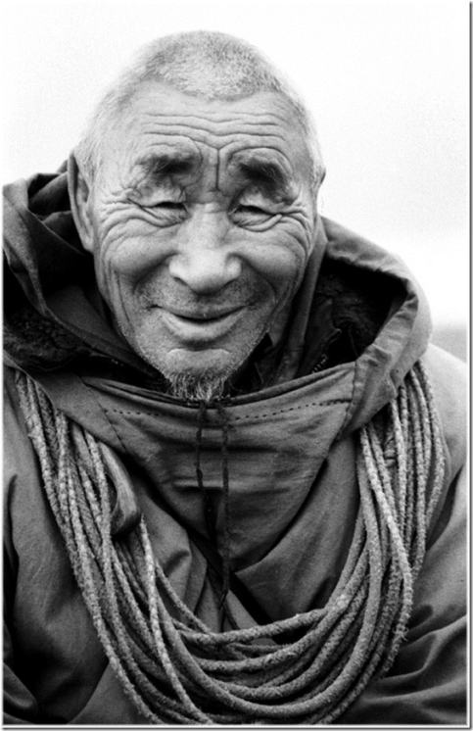
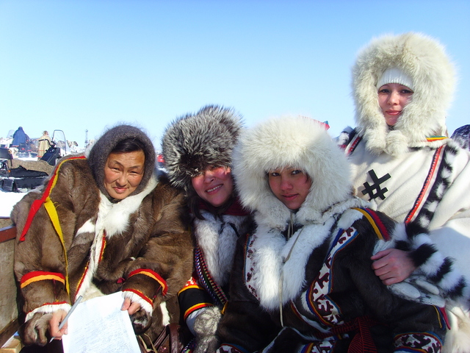
The extinction of languages
42 % of the Saami considered native Sami language,
while 58 %Russian
23% of the Nivkh considered native Nivkh language
and 77 %Russian
The most Patriotic-Nganasans, 84% speak their native language

Slide 11
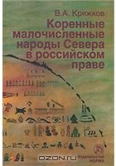
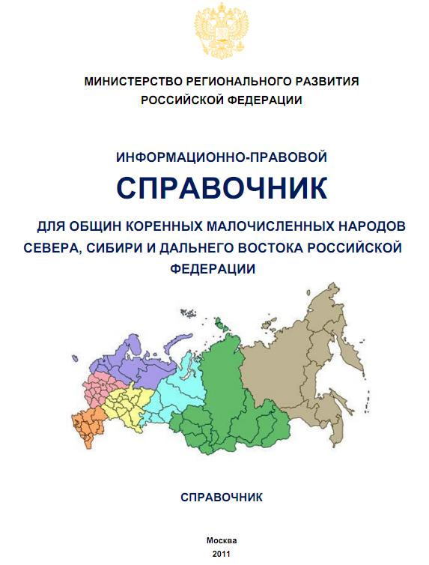
1995 - 2004 the International decade of indigenous peoples of the world.

Slide 12
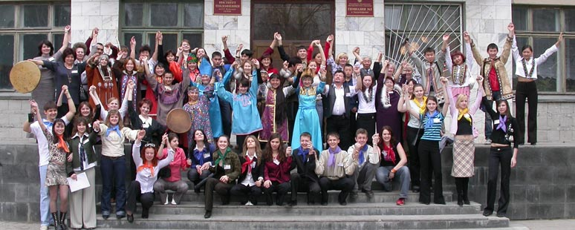
Since 2003, gymnasium №3 is a participant of the Interregional project of the NSU «Increasing opportunities of indigenous peoples of Siberia in obtaining a high level of education», which was supported by European Union Program «European initiative for democracy and human rights».

Slide 13
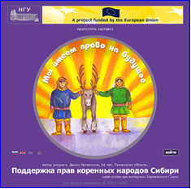
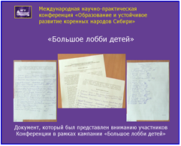
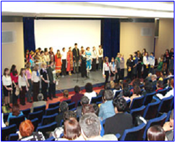
«The Big Lobby» for children
the International scientific and practical conference «Education and sustainable development of indigenous peoples of Siberia»

Slide 14
